Slide 1

Test Automation
TFS ALM using Selenium and SpecFlow

Slide 2
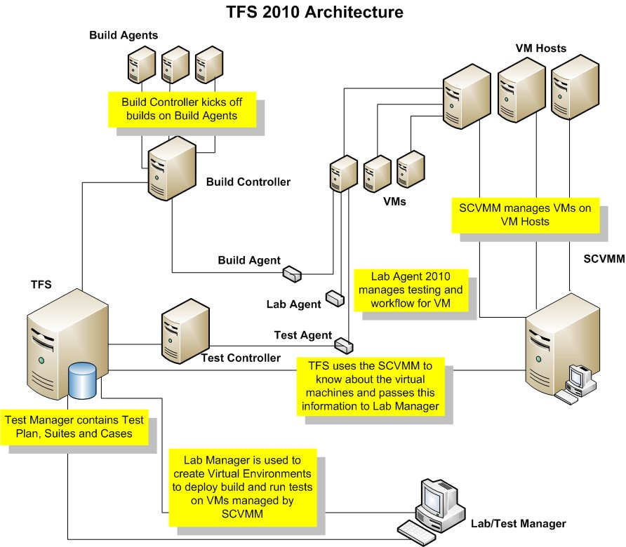
TFS ALM
TFS ALM Architecture
The TFS ALM Architecture looks after a complete end to end solution. (Build, Deploy, Test)

Slide 3
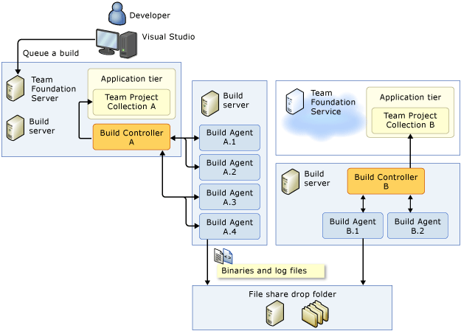
TFS ALM – Continues…
Build and Deploy Process
There should already be existing architecture to support build definitions in CPA

Slide 4
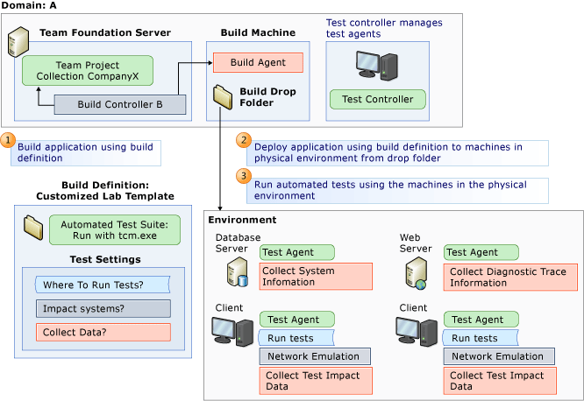
TFS ALM– Continues…
Test process
Automated tests can be run against physical and virtual environments
https://msdn.microsoft.com/en-us/library/ff972305(v=vs.100).aspx

Slide 5
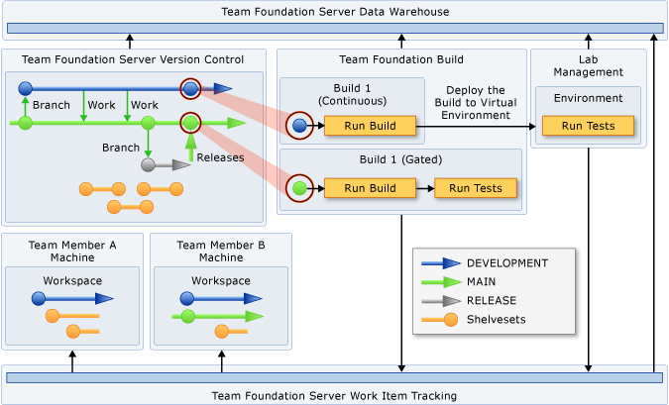
TFS ALM – Build Definitions
CI and Command Line Test Execution
CI coexists with other build types.

Slide 6
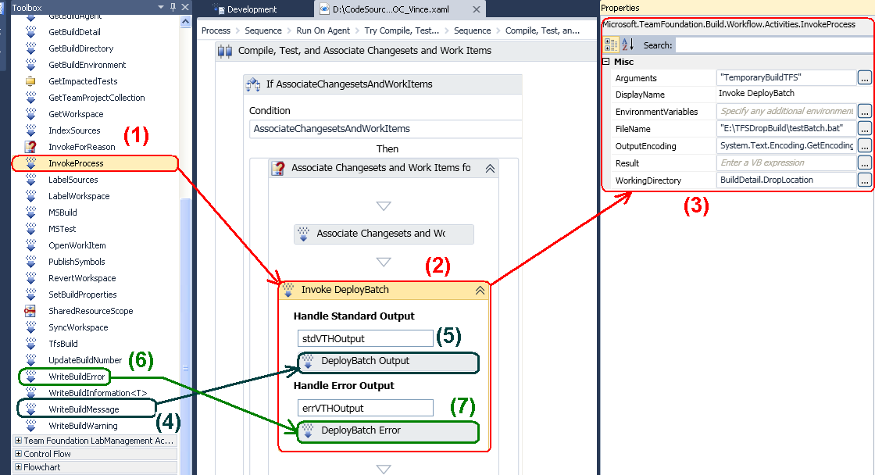
TFS ALM – Build Definitions - Continues
Customised Build Definitions
They are customisable through windows workflow and custom code activities.

Slide 7
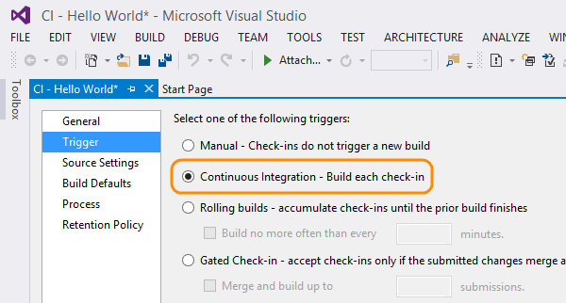
TFS ALM – Build Definitions - Continues
Different Trigger Options
They can be triggered to run by many different methods.

Slide 8
CPA Test Automation
Planit’s Solution
The project is stored within TFS. It is build and deployed the same way other applications in TFS are.
Planit Framework
Visual C# Unit Test Project
Selenium Library
Test Class -Test Method1 - Test Method2…
Property Settings - Brower Type - TestEnvironment - WaitTimes
Page Model - CustomerIDText - PasswordTest - ClickLoginButton
SpecFlow Feature -Test Scenario1 - Test Scenario2…
SpecFlow Steps -Step Method1 - Step Method2…
Common Class - GET Method - SET Method - CLICK Method

Slide 9
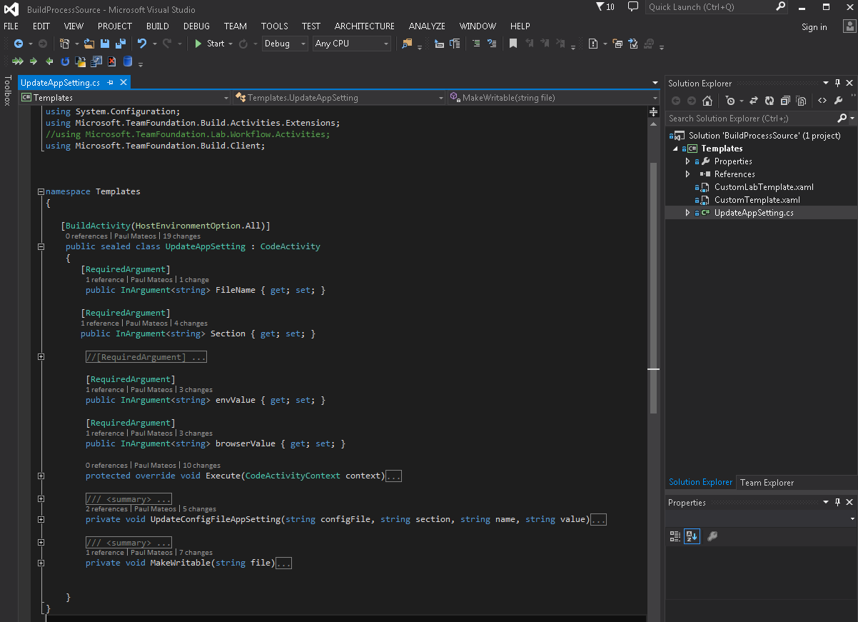
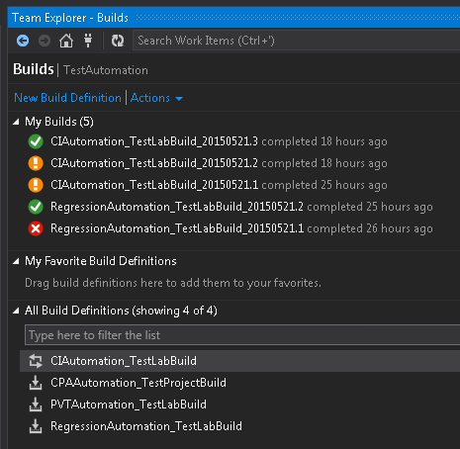
CPA Test Automation – continues…
Planit’s Solution
Custom Build Definitions have been created to run the CI process. A Custom Code Activity has also been created to update the property settings file with the Build Definition arguments.

Slide 10
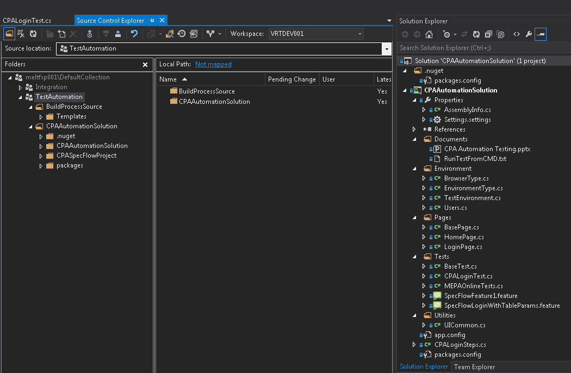
CPA Test Automation – continues…
Planit’s Solution
The test cases are stored and build as a standard visual studios project.

Slide 11
Questions?
We Appreciate Your Participation!
Paul Mateos Technical Team Lead
pmateos@planit.net.au
Michael Pollino Technical Test Consultant
mpollino@planit.net.au

